Slide 1
CIS 508 Machine Learning in Business Assignment - 2
Done by: Ishika Gupta - 1229311176

Slide 2
Problem Statement
To Use Python Scikit Learn to solve both the target marketing and the fraud detection binary classification problems

Slide 3
Fraud Detection
Binary Classification

Slide 4
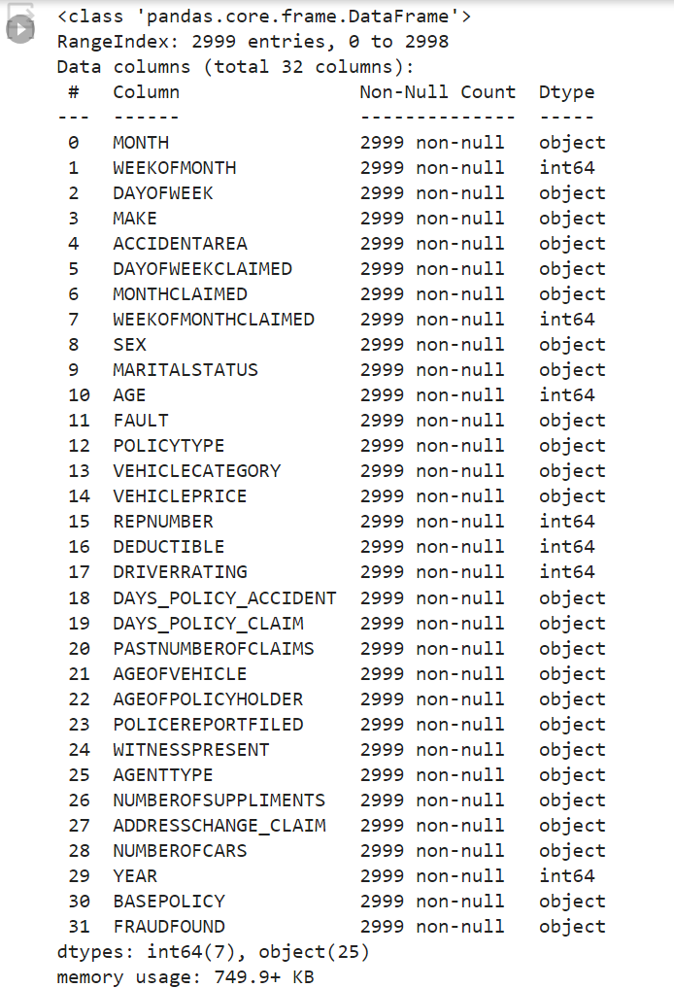
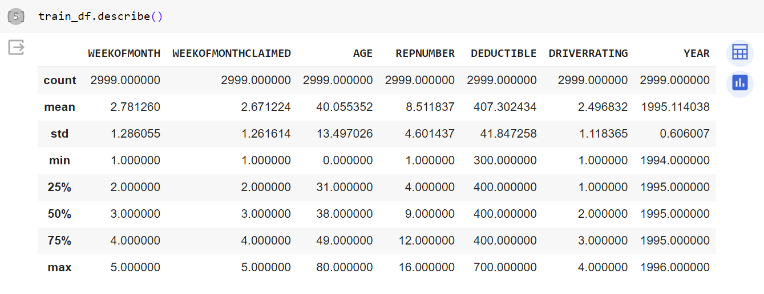
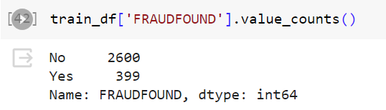
Dataset
Training Data – 2999 rows, 32 columns
Testing Data – 12918 rows, 32 columns.
Mix of numerical and categorical columns
No missing values
Imbalanced Dataset
Data collected over a period of 3 years

Slide 5
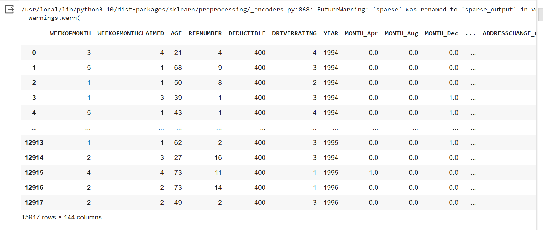
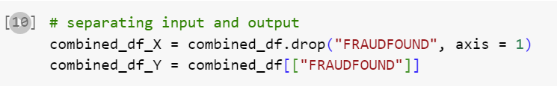
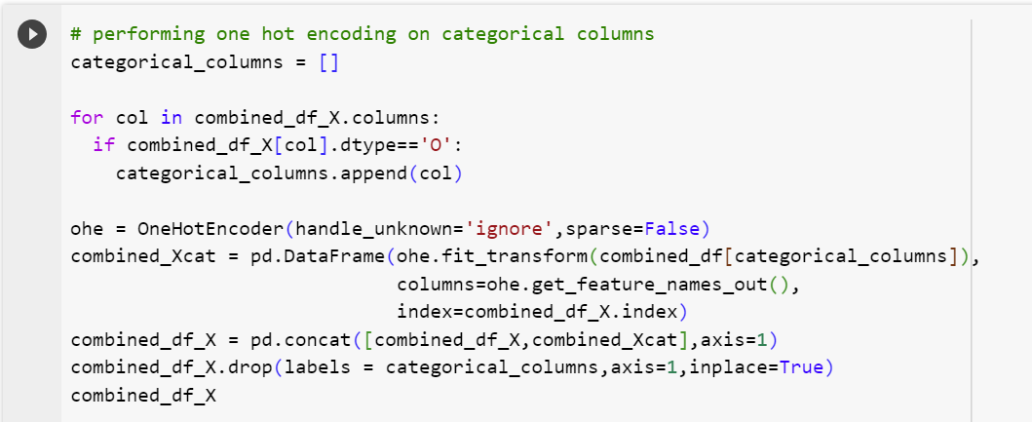
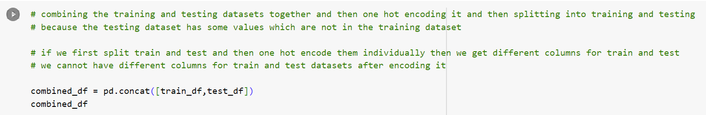
Data Preprocessing – One Hot Encoding
The number of columns increased from 32 to 144 after performing one hot encoding

Slide 6

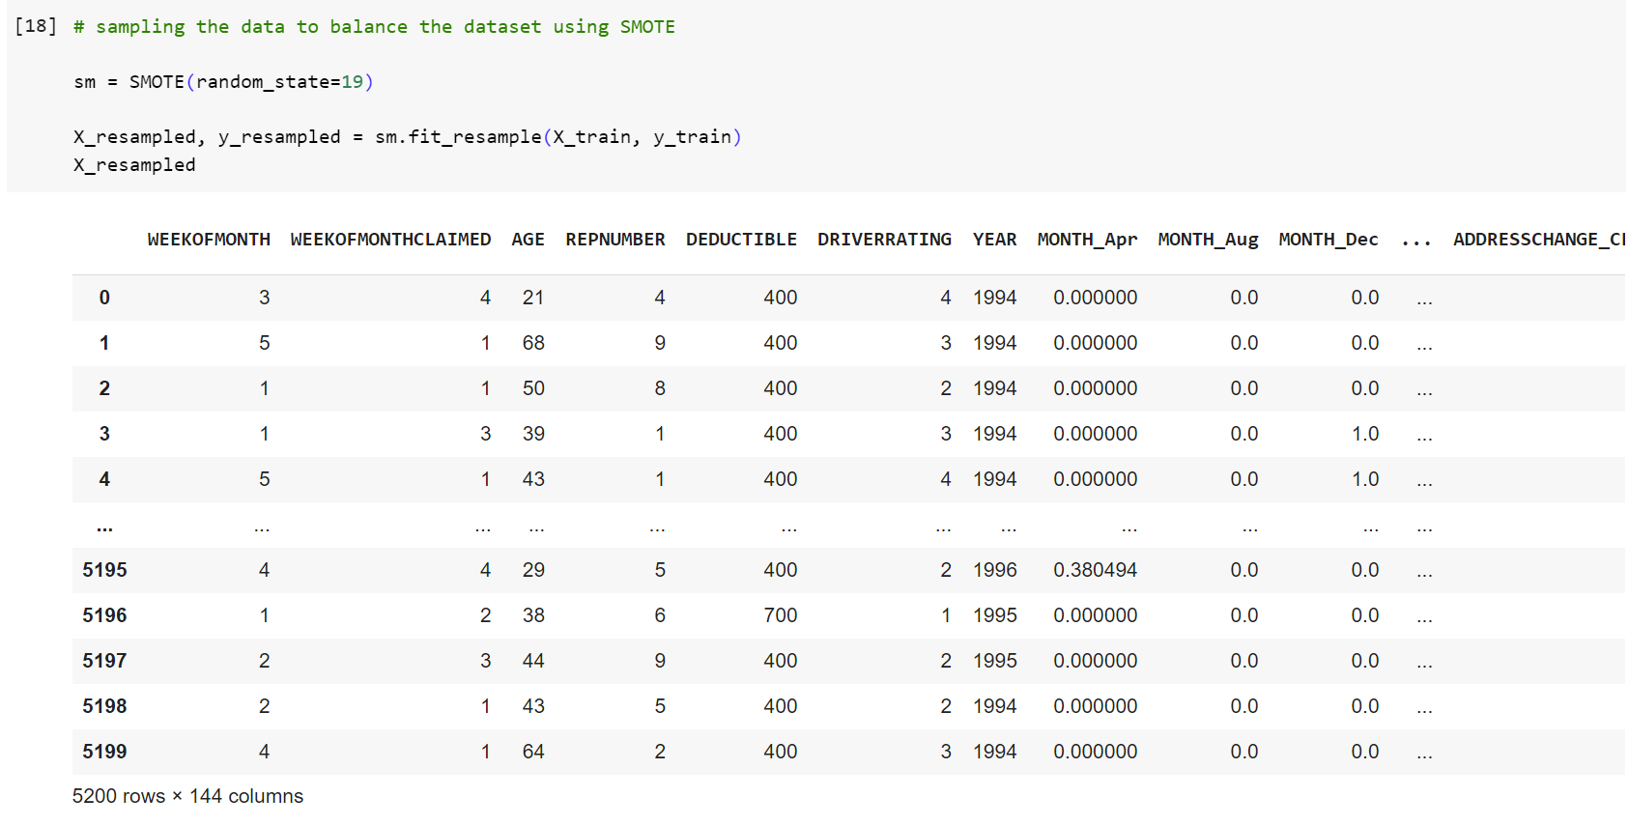



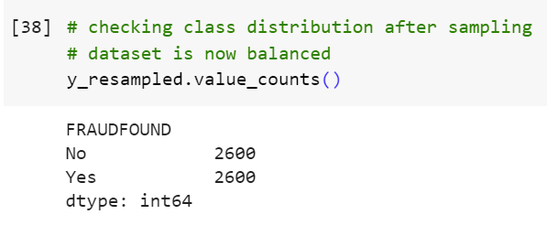
Data Preprocessing – SMOTE Oversampling
Separated the input and output features of the training and testing from the combined dataset using indexing.
2. Performed SMOTE oversampling on the training dataset to balance the dataset.

Slide 7
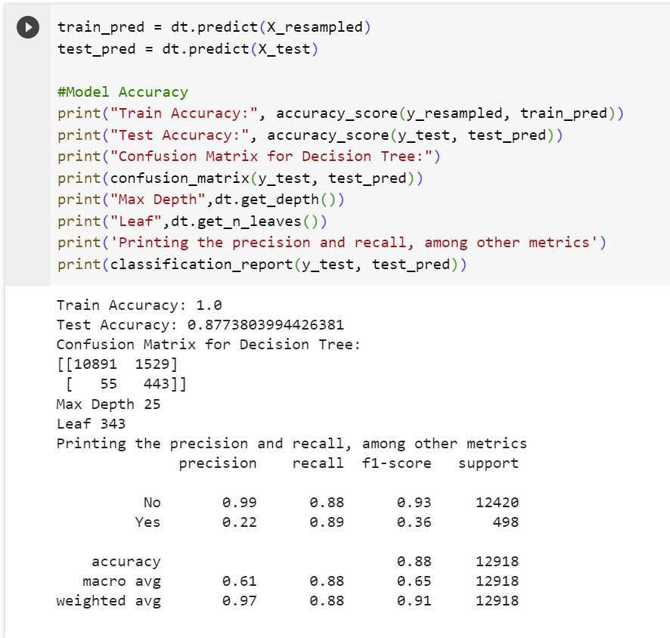
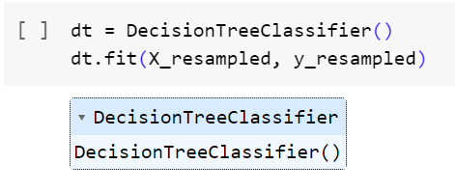
Models
1. Decision Trees – No hyperparameter tuning, only default parameters

Slide 8
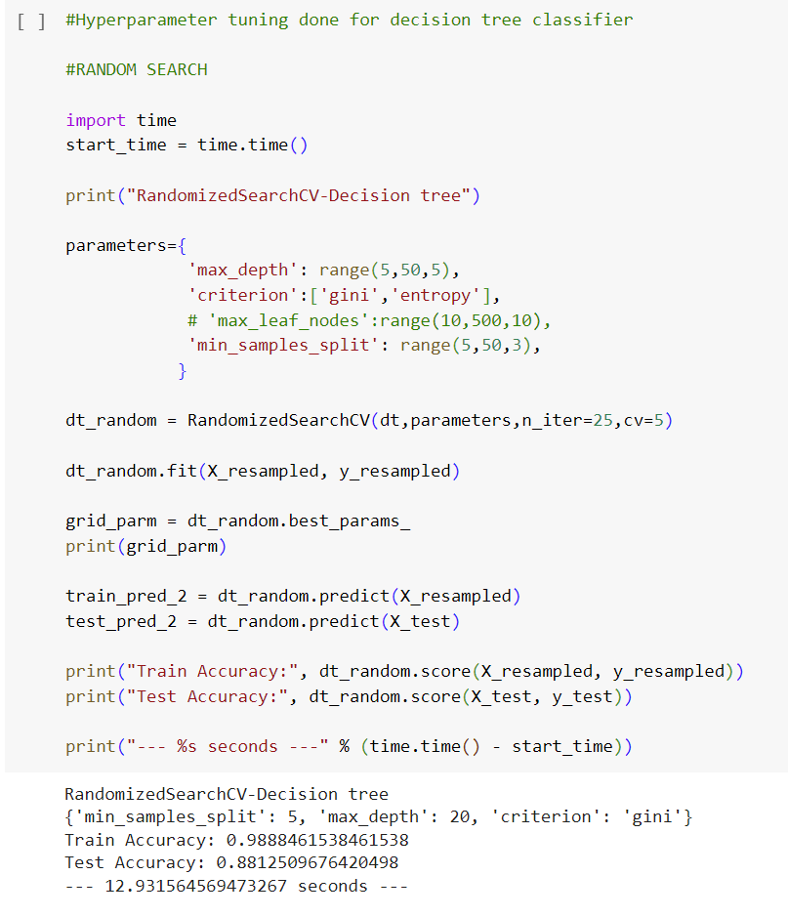
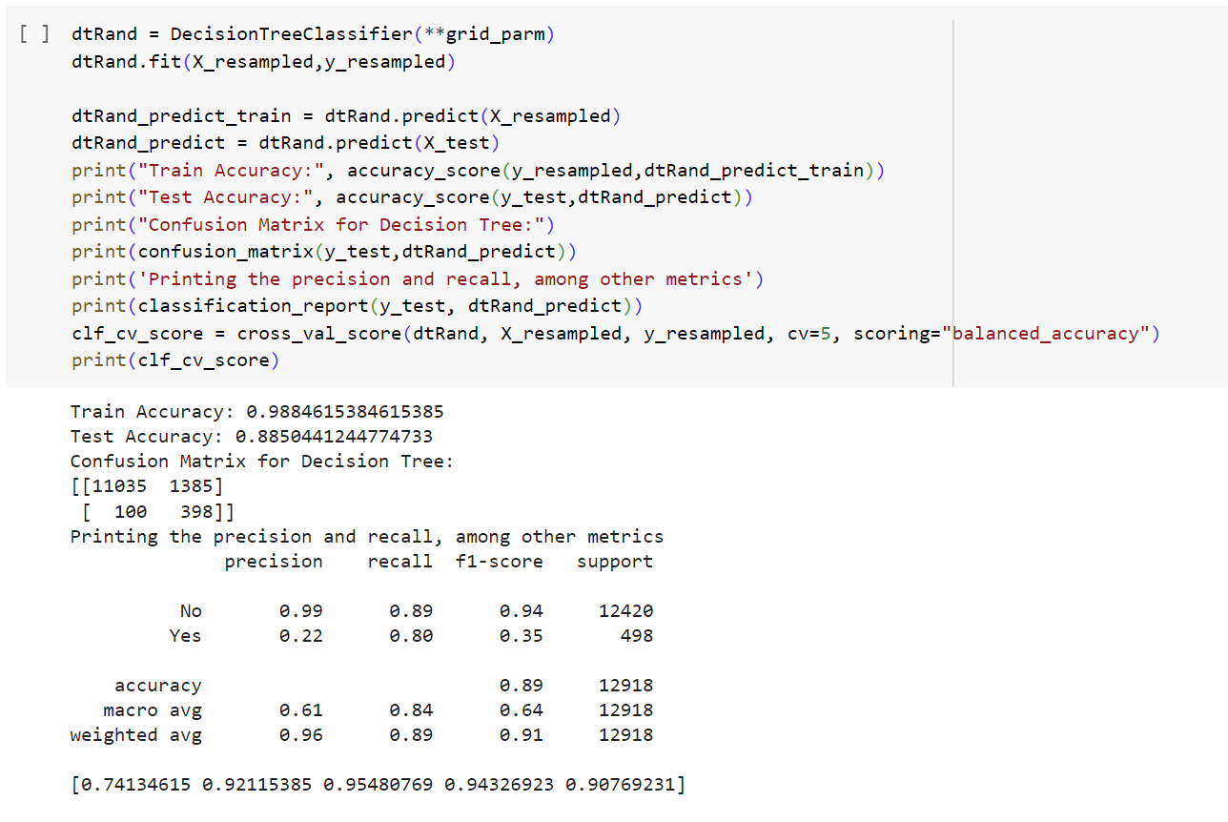
2. Decision Tree – Random Search Hyperparameter tuning

Slide 9
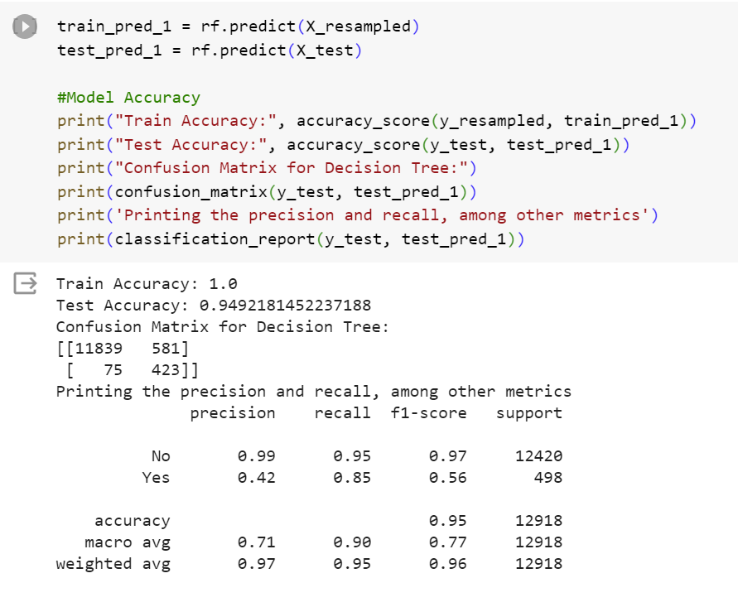
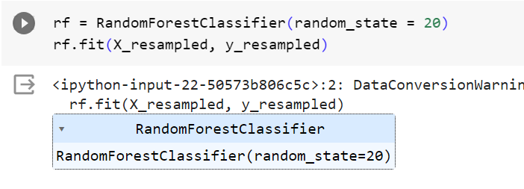
3. Random Forest – No hyperparameter tuning, only default parameters

Slide 10
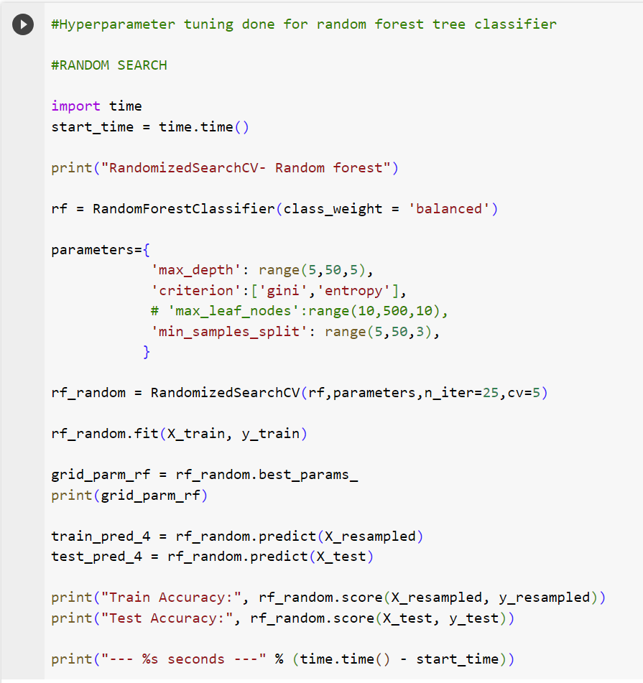
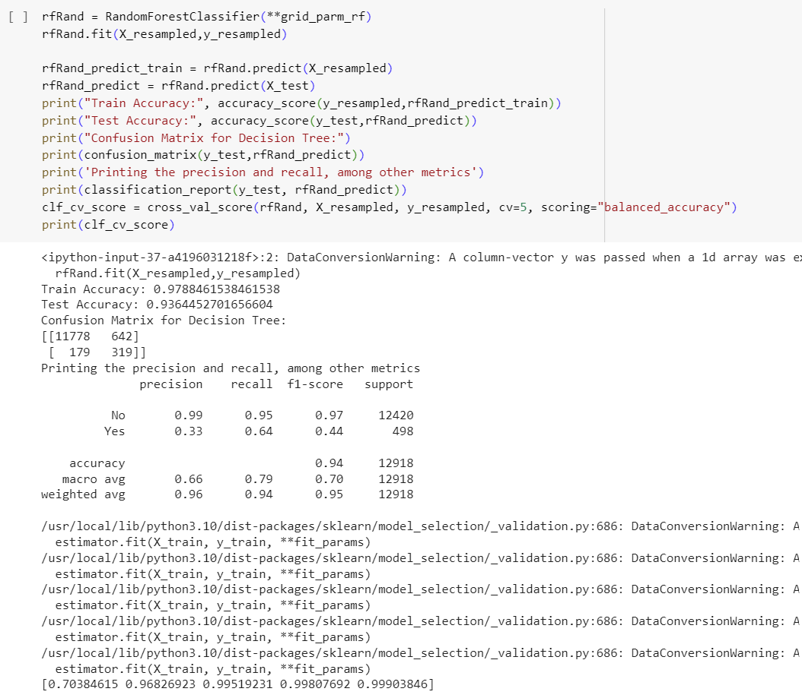
4. Random forest – random search HYPERPARAMETER TUNING

Slide 11
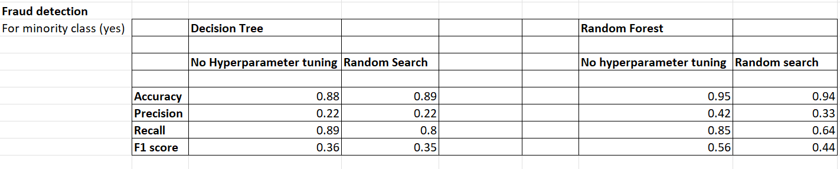
Fraud Detection – Models Summary
Accuracy measure can be misleading for imbalanced datasets – Need to focus on Precision and Recall
Recall is significantly higher than Precision
High Recall, low precision – model is following a ‘Better be safe than sorry’ strategy. Its flagging as many transactions as it can as fraudulent (at the cost of flagging legitimate transactions as fraudulent), so that it does not miss out on any transactions that are actually fraudulent to save the customer’s money from being stolen.
We also got a low f1-score which means that either precision and recall is low. A high f1 score should be ideal, which indicates that both precision and recall are high.

Slide 12
Target Marketing
Binary classification

Slide 13
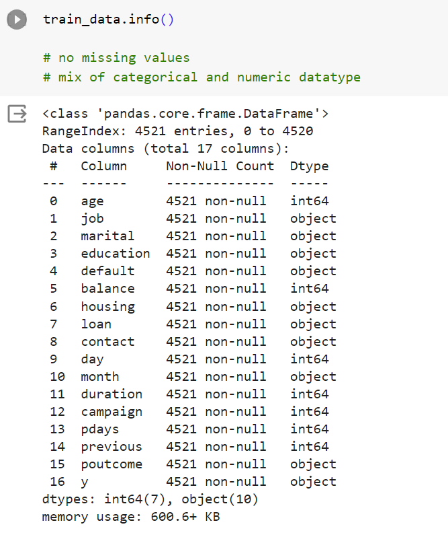
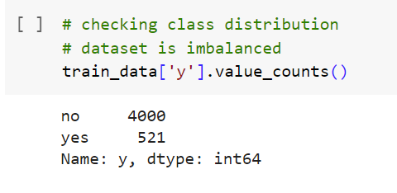
Dataset
Training Data – 4521 rows, 17 columns
Testing Data – 45211 rows, 17 columns
Mix of numerical and categorical features
No missing values
Imbalanced dataset
Target feature: y (yes and no) – Binary classification

Slide 14
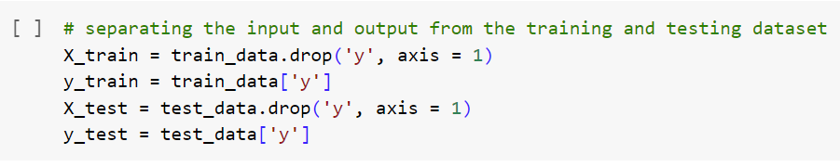
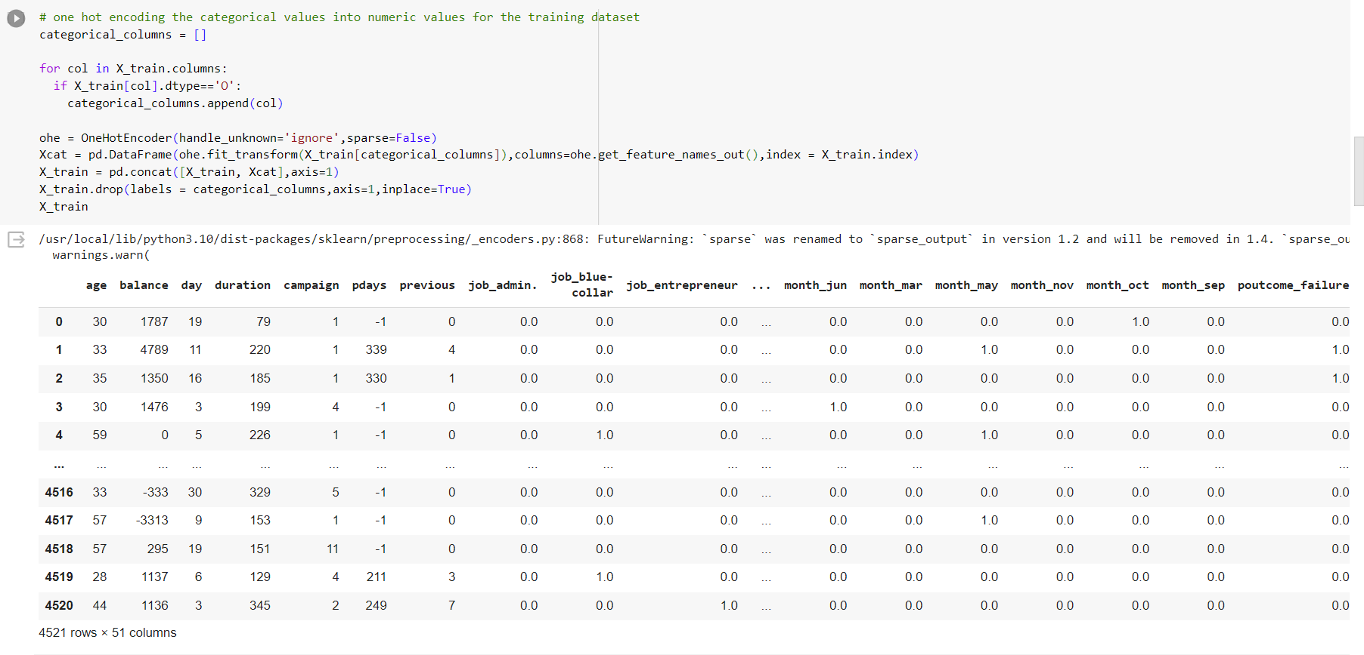
Data Preprocessing – One Hot Encoding
Separated input and output for training and testing data
One hot encoded training data
Number of columns increased from 17 to 51 after one hot encoding

Slide 15
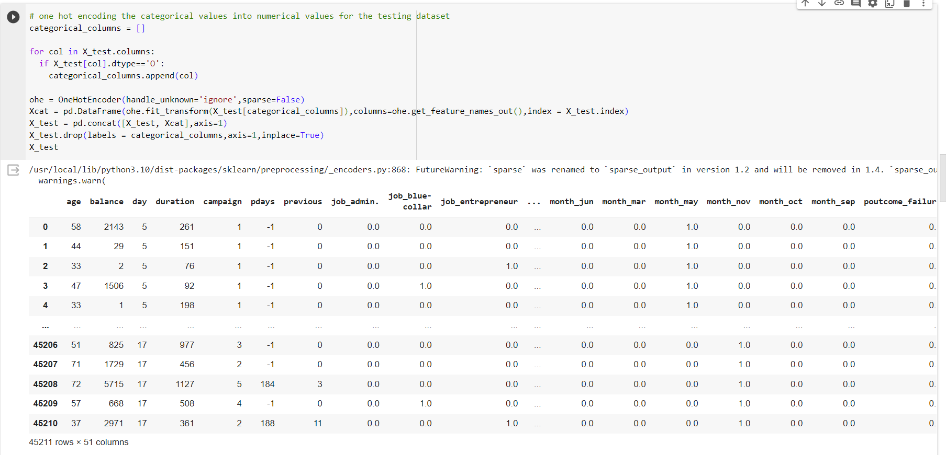
Data Preprocessing – One Hot Encoding
One hot encoding the testing dataset

Slide 16
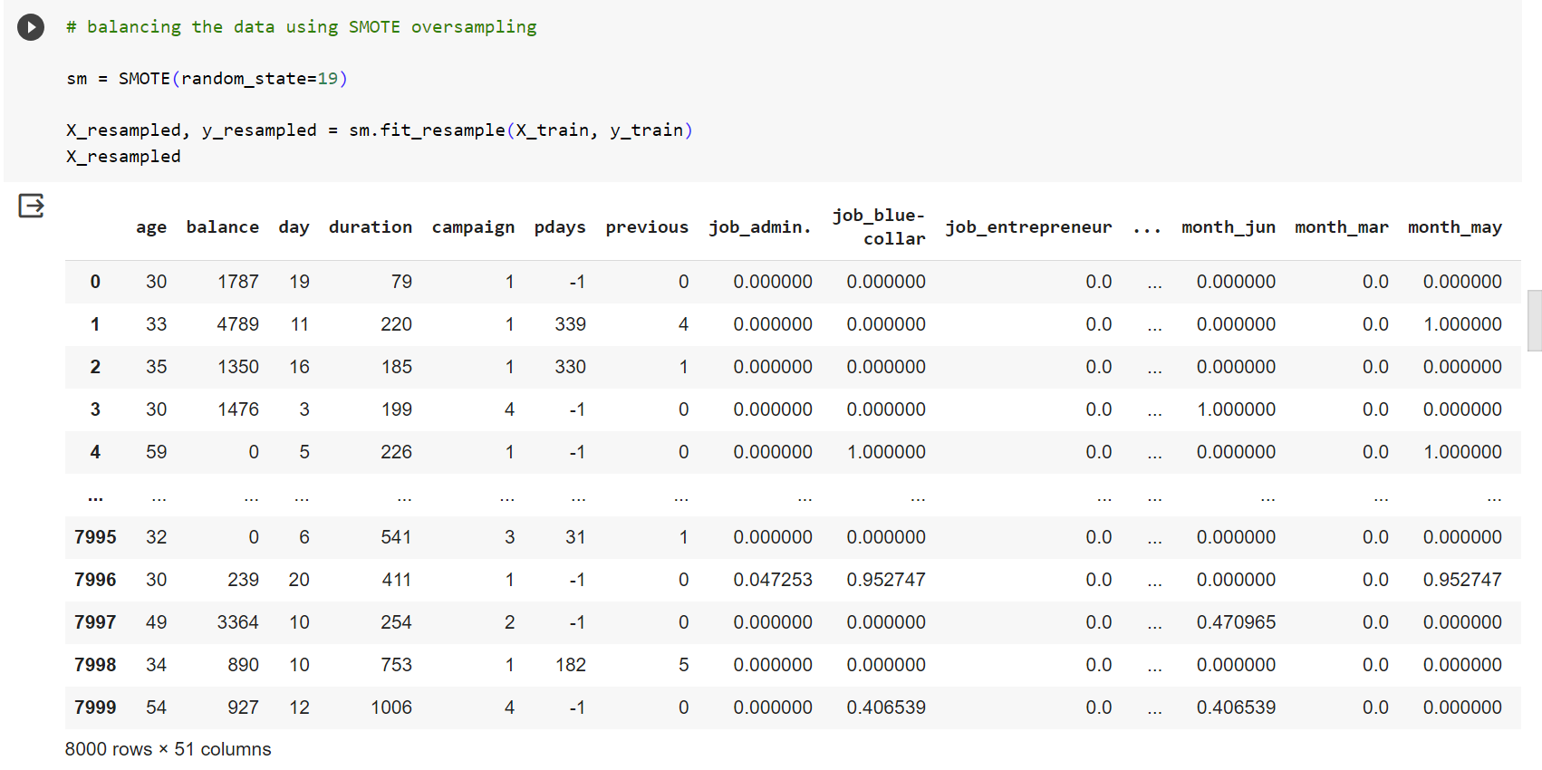
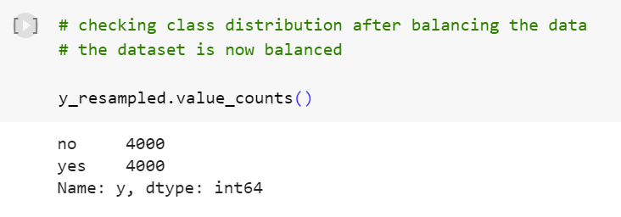
Data Preprocessing – SMOTE Oversampling
Balancing the dataset
Number of rows increased from 4521 to 8000

Slide 17
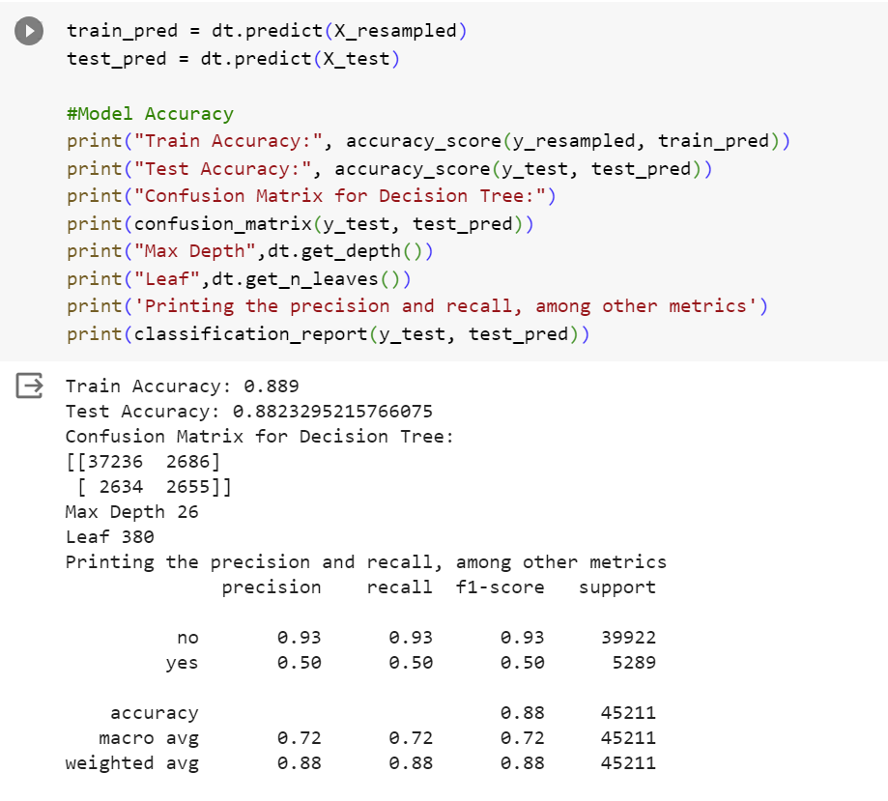
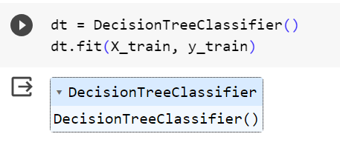
Models
Decision Tree – No hyperparameter tuning

Slide 18
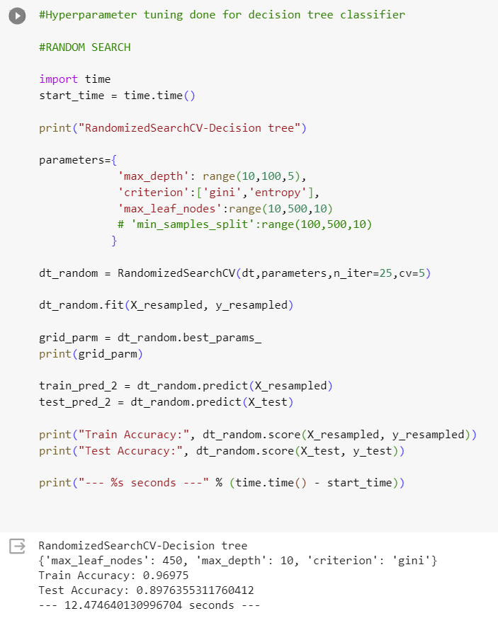
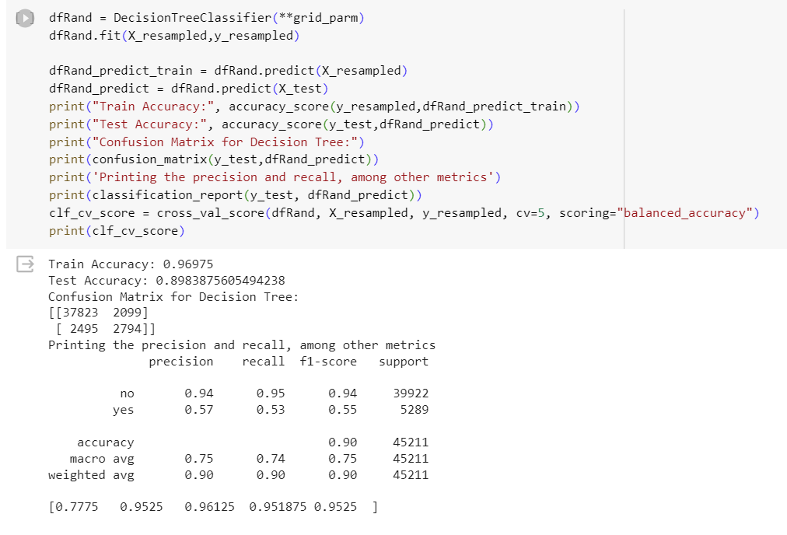
2. Decision Tree – Random Search Hyperparameter tuning

Slide 19
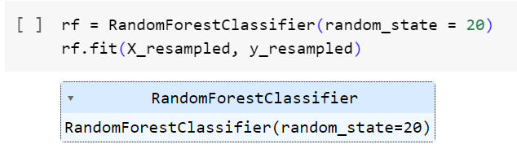
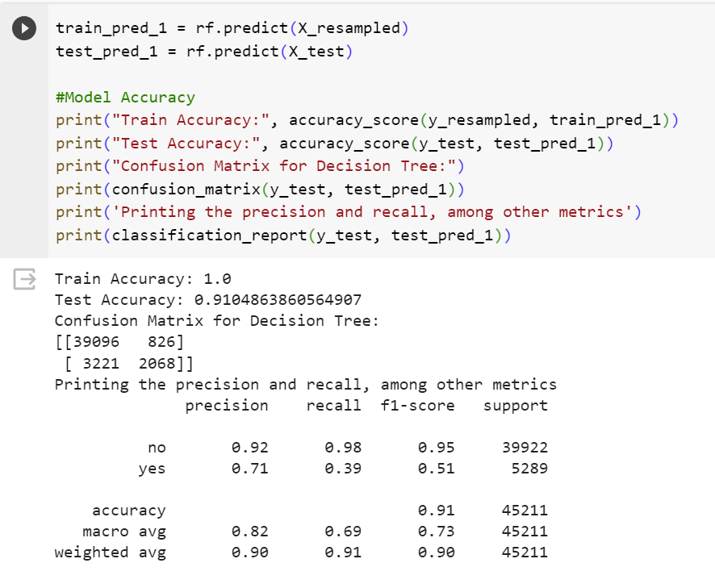
3. Random Forest – No hyperparameter tuning

Slide 20
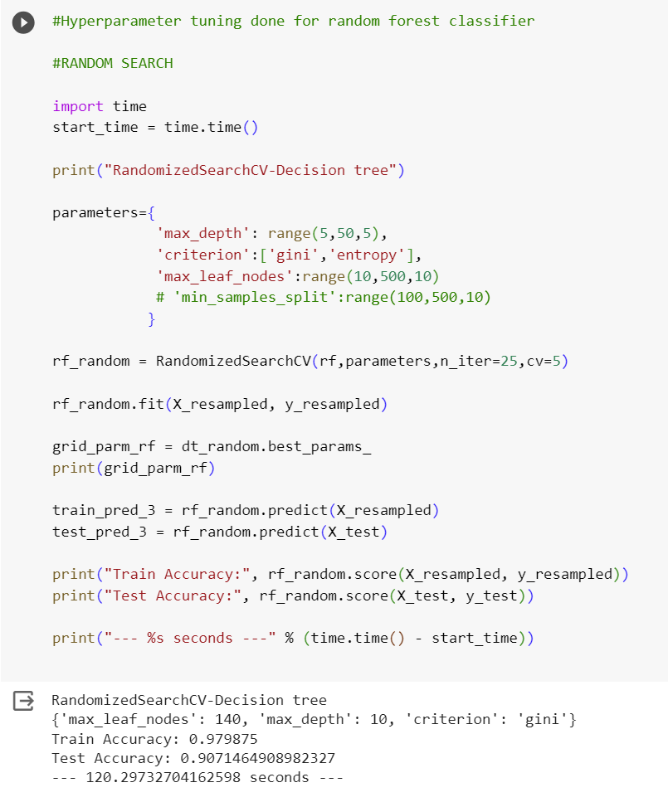
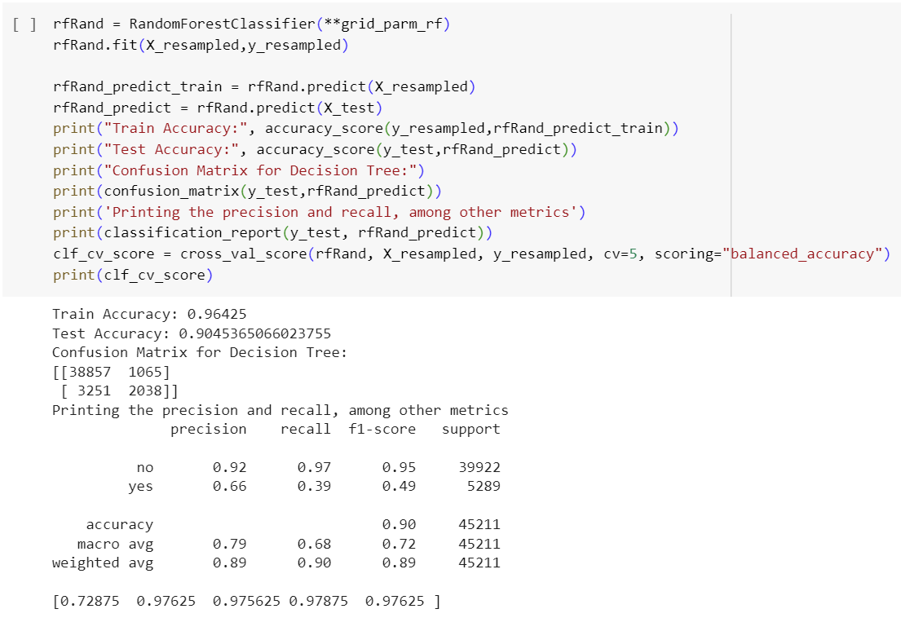
4. Random Forest – Random Search hyperparameter tuning

Slide 21
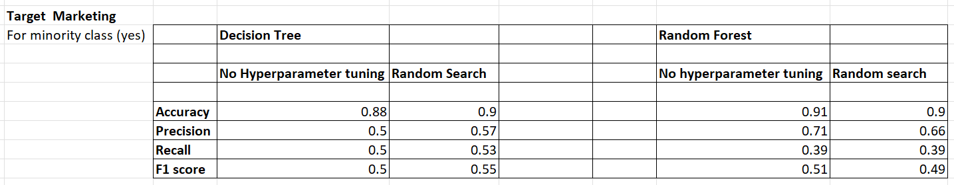
Target Marketing – Models summary
Imbalanced dataset – Accuracy can be misleading, consider precision and recall
Precision is higher than recall
High precision and low recall – the model is being picky / skeptical about which records belong to the positive class – unable to identify most of the positive records. It doesn’t classify a record as a positive unless and until it has overwhelming evidence. So when it does classify a record as positive, believe it.
We also got a low f1-score which means that either precision and recall is low. A high f1 score should be ideal, which indicates that both precision and recall are high.

Slide 22
Conclusion
1. Accuracy is misleading for imbalanced datasets – precision and recall tell us more accurately about model performance
2. Random forest models perform better when compared to decision trees
3. Choosing between Random Search and Grid Search is a trade off between run-time and quality of model. Grid search can give high quality results but is very computationally expensive – it takes too much time. Random Search is quick, but does not guarantee that the ‘best’ hyperparameters it found is actually the best.
4. With random forests, we do not need to worry about the ranges of the hyperparameters being very close to the ideal hyperparameter values because random forests will create multiple independent decision trees whose individual errors can help reduce the total error.

Slide 23
Thank you

